Slide 2
solve problems based on time and amount computation.

Slide 3
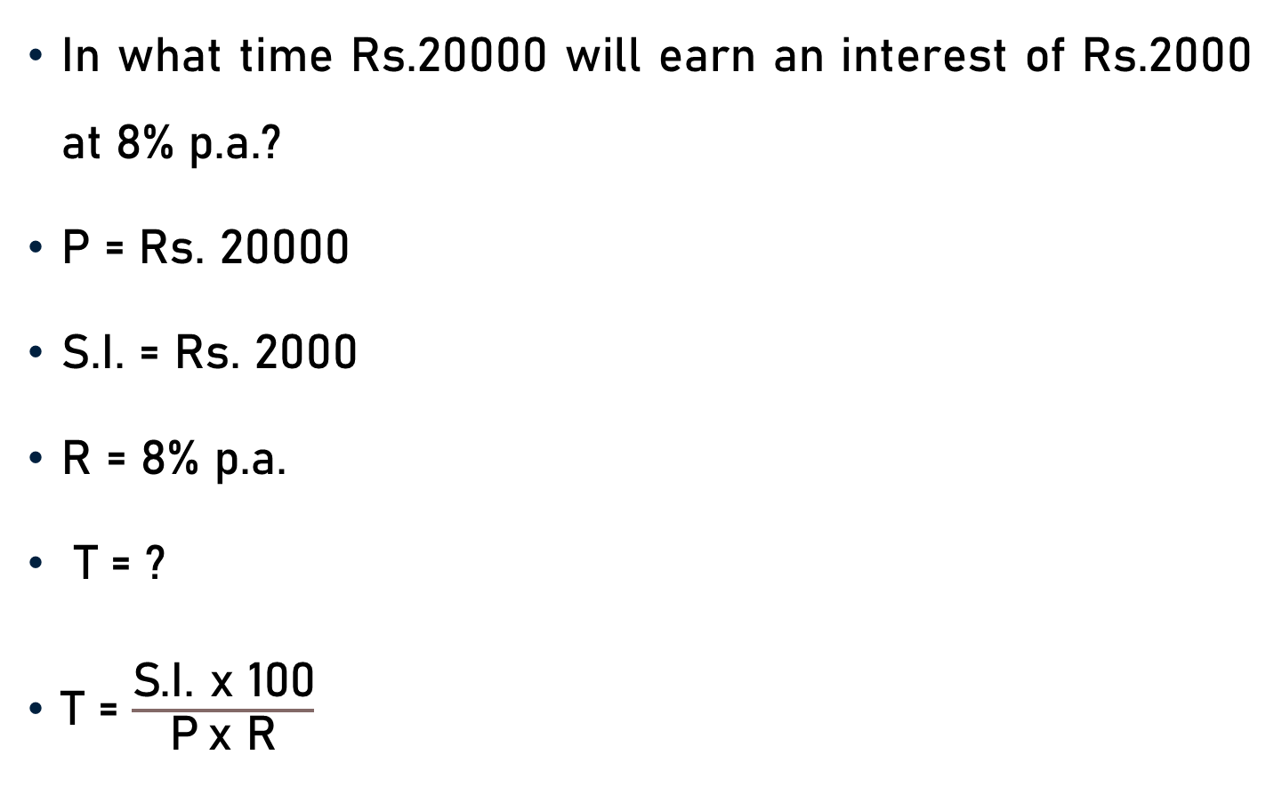
Problem 1
In what time Rs.20000 will earn an interest of Rs.2000 at 8% p.a.?
P = Rs. 20000
S.I. = Rs. 2000
R = 8% p.a.
T = ?
$\text{T}$ = $\frac{\text{S}\text{.}\text{I}\text{. }\text{x}\text{ 100}}{\text{P} \text{x} \text{R}}$

Slide 4

Problem 1
$\text{T}$ = $\frac{\text{S}\text{.}\text{I}\text{. }\text{x}\text{ 100}}{\text{P} \text{x} \text{R}}$
T = $\frac{\text{2000} \text{x}\text{ 100}}{\text{20000} \text{x}\text{ 8 }}$
T = 1 $\frac{\text{1}}{\text{4}}$ years
T = 1.25 years
T = 1 year and 3 months
5
10
10
4

Slide 5
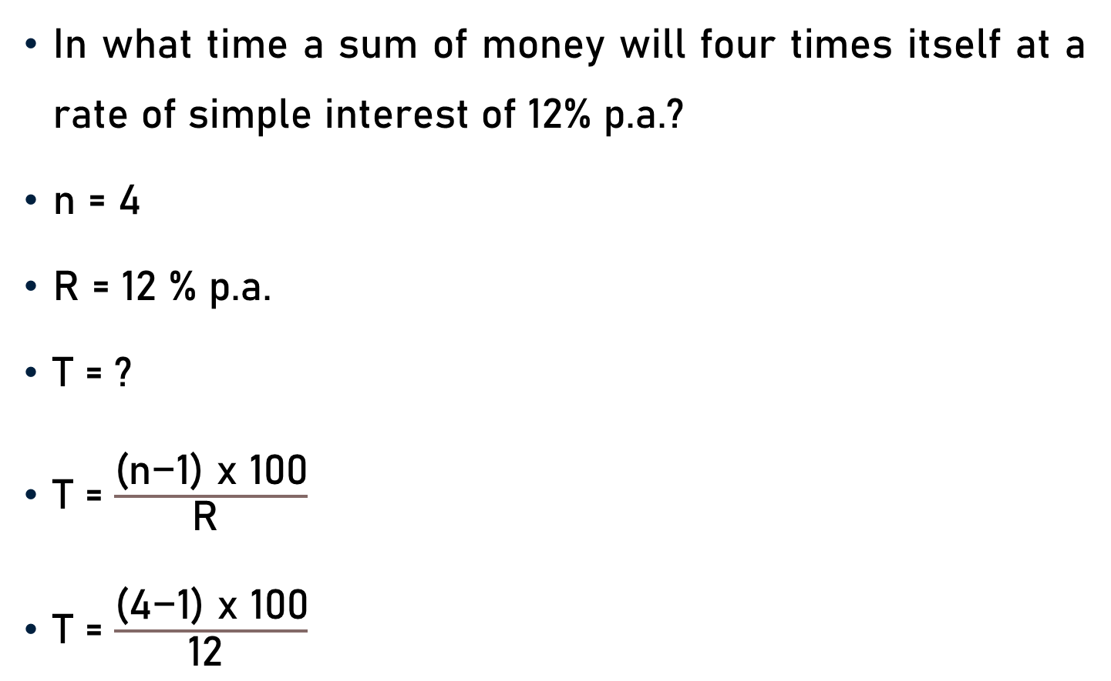
Problem 2
In what time a sum of money will four times itself at a rate of simple interest of 12% p.a.?
n = 4
R = 12 % p.a.
T = ?
$\text{T}$ = $\frac{\text{(}\text{n}\text{−1) }\text{x}\text{ 100}}{\text{R} }$
$\text{T}$ = $\frac{\text{(}\text{4}\text{−1) }\text{x}\text{ 100}}{\text{12} }$

Slide 6

Problem 2
$\text{T}$ = $\frac{\text{(}\text{4}\text{−1) }\text{x}\text{ 100}}{\text{12} }$
$\text{T}$ = $\frac{\text{(}\text{3}\text{) }\text{x}\text{ 100}}{\text{12} }$
T = 25 years
25
4

Slide 7

Problem 3
In how many years will a sum of money double itself at 13$\frac{\text{1}}{\text{2 }}$% p.a.?
n = 2
R = 13$\frac{\text{1}}{\text{2 }}$ = $\frac{\text{27}}{\text{2 }}$%
T = ?
$\text{T}$ = $\frac{\text{(}\text{n}\text{−1) }\text{x}\text{ 100}}{\text{R} }$

Slide 8

Problem 3
$\text{T}$ = $\frac{\text{(}\text{n}\text{−1) }\text{x}\text{ 100}}{\text{R} }$
$\text{T}$ = $\frac{\text{(}\text{2}\text{−1) }\text{x}\text{ 100}}{\frac{\text{27}}{\text{2 }}}$
$\text{T}$ = $\frac{\text{(}\text{1}\text{) }\text{x}\text{ 100 }\text{x}\text{ 2}}{\text{27} }$
$\text{T}$ = $\frac{\text{2}\text{00}}{\text{27} }$
T = 7 $\frac{\text{11}}{ \text{27} }$ years

Slide 9
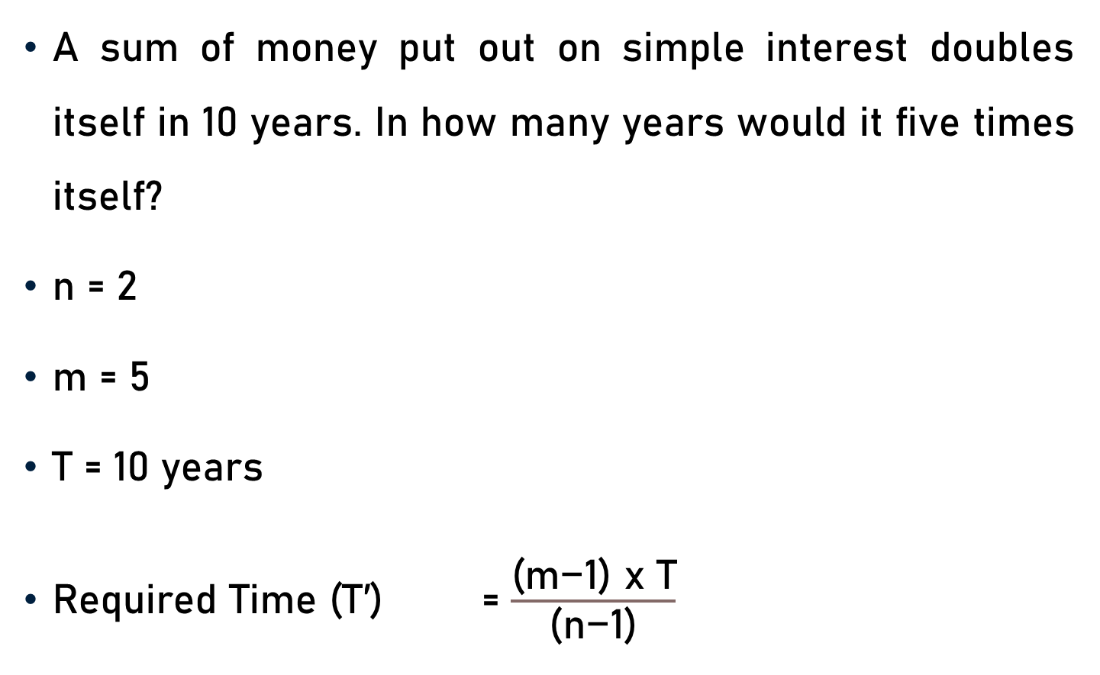
Problem 4
A sum of money put out on simple interest doubles itself in 10 years. In how many years would it five times itself?
n = 2
m = 5
T = 10 years
$\text{Required} \text{Time}\text{ (}\text{T}\text{′)}$ = $\frac{\text{(}\text{m}\text{−1) }\text{x} \text{T}}{\text{(}\text{n}\text{−1)}}$

Slide 10

Problem 4
n = 2, m = 5, and T = 10 years
$\text{Required} \text{Time}\text{ (}\text{T}\text{′)}$ = $\frac{\text{(}\text{m}\text{−1) }\text{x} \text{T}}{\text{(}\text{n}\text{−1)}}$
= $\frac{\text{(}\text{5}\text{−1) }\text{x}\text{ 10}}{\text{(}\text{2}\text{−1) }}$
= $\frac{\text{(}\text{4}\text{) }\text{x}\text{ 10}}{\text{(}\text{1)} }$
= 40 years

Slide 11
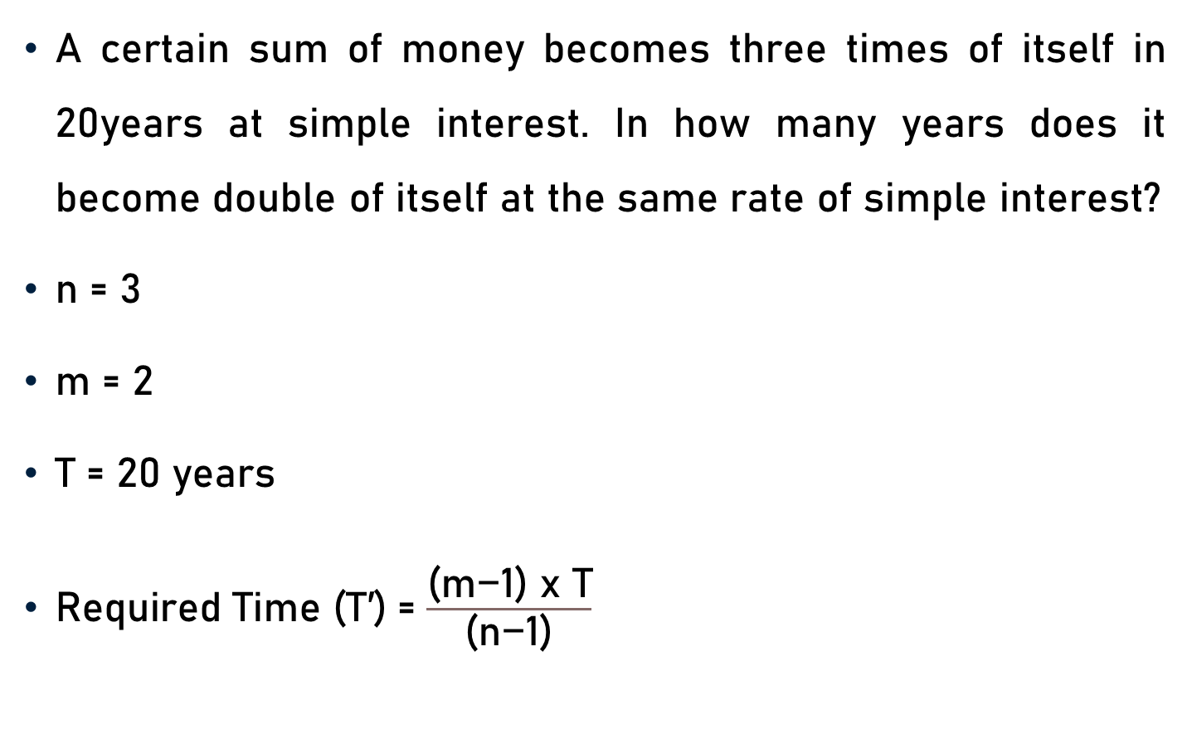
Problem 5
A certain sum of money becomes three times of itself in 20years at simple interest. In how many years does it become double of itself at the same rate of simple interest?
n = 3
m = 2
T = 20 years
$\text{Required} \text{Time}\text{ (}\text{T}\text{′)}$ = $\frac{\text{(}\text{m}\text{−1) }\text{x} \text{T}}{\text{(}\text{n}\text{−1)}}$

Slide 12

Problem 5
n = 3, m = 2, and T = 20 years
$\text{Required} \text{Time}\text{ (}\text{T}\text{′)}$ = $\frac{\text{(}\text{m}\text{−1) }\text{x} \text{T}}{\text{(}\text{n}\text{−1)}}$
= $\frac{\text{(}\text{2}\text{−1) }\text{x}\text{ 20}}{\text{(}\text{3}\text{−1) }}$
= $\frac{\text{(}\text{1}\text{) }\text{x}\text{ 20}}{\text{(}\text{2}\text{)} }$
= 10 years
10

Slide 13
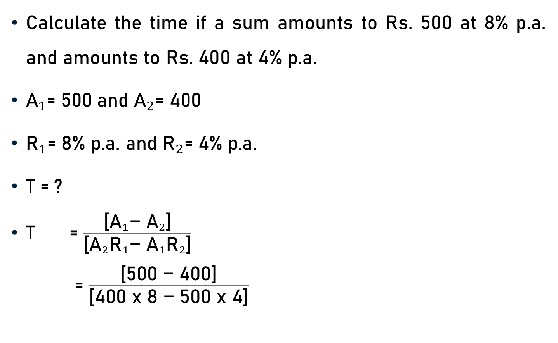
Problem 6
Calculate the time if a sum amounts to Rs. 500 at 8% p.a. and amounts to Rs. 400 at 4% p.a.
${\text{A}}_{1}\text{= }\text{5}\text{00}$ $\text{and} {\text{A}}_{2}\text{= 400}$
${\text{R}}_{1}\text{= 8\% }\text{p}\text{.}\text{a}\text{.}$ $\text{and} {\text{R}}_{2}\text{=}$ $\text{4\% }\text{p}\text{.}\text{a}\text{.}$
$\text{T}\text{ = ?}$
$\text{T}$ = $\frac{\text{[}{{\text{A}}_{1}\text{−} \text{A}}_{2}\text{]}}{\text{[}{\text{A}}_{2}{\text{R}}_{1}\text{−} {{\text{A}}_{1}\text{R}}_{2}\text{]}}$
= $\frac{\text{[500 }\text{−}\text{ 400]}}{\text{[400 }\text{x}\text{ 8 }\text{−}\text{ 500 }\text{x}\text{ 4]}}$

Slide 14
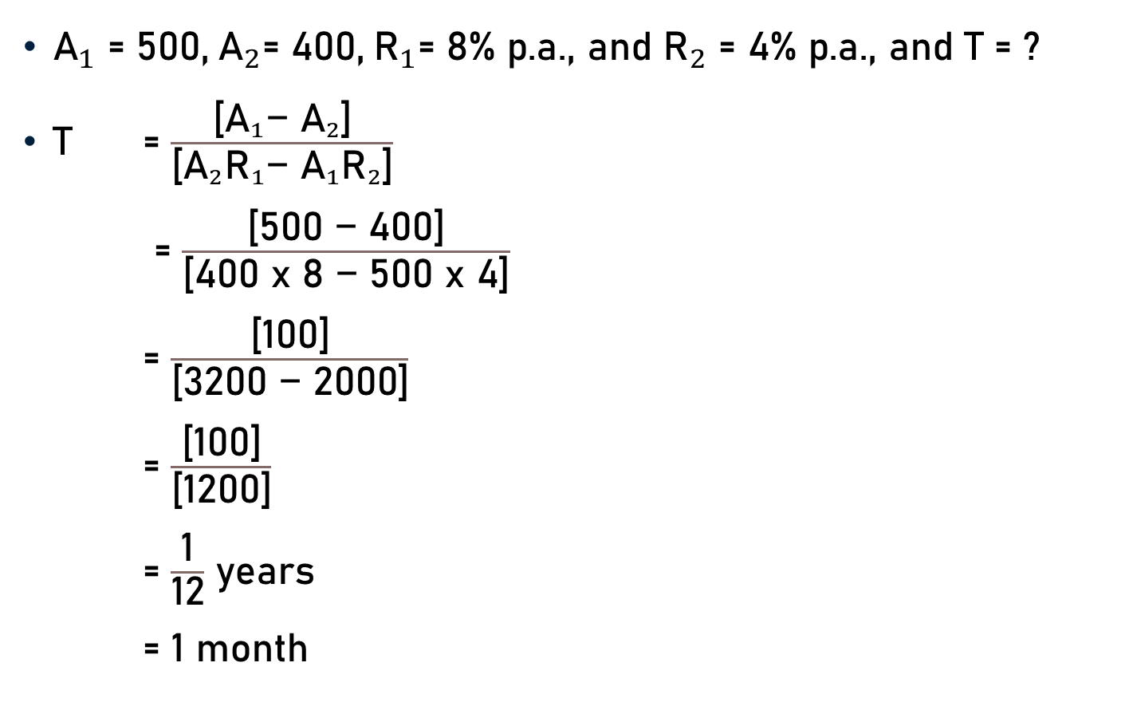
Problem 6
${\text{A}}_{1}{\text{= 500,} { \text{A}}_{2}\text{= 400,}{ \text{R}}_{1}\text{= 8\% }\text{p}\text{.}\text{a}\text{., }\text{and} \text{R}}_{2}\text{= 4\% }\text{p}\text{.}\text{a}\text{., }\text{and} \text{T}\text{ = ?}$
$\text{T}$ = $\frac{\text{[}{{\text{A}}_{1}\text{−} \text{A}}_{2}\text{]}}{\text{[}{\text{A}}_{2}{\text{R}}_{1}\text{−} {{\text{A}}_{1}\text{R}}_{2}\text{]}}$
= $\frac{\text{[}\text{500 }\text{−}\text{ 4}\text{00]}}{\text{[400 }\text{x}\text{ 8 }\text{−} \text{5}\text{00 }\text{x}\text{ 4]}}$
= $\frac{\text{[}\text{1}\text{00]}}{\text{[}\text{32}\text{00 }\text{−} \text{20}\text{00]}}$
= $\frac{\text{[}\text{1}\text{00]}}{\text{[}\text{1200}\text{]}}$
= $\frac{\text{1}}{\text{12}}$ years
= 1 month
1
12

Slide 15
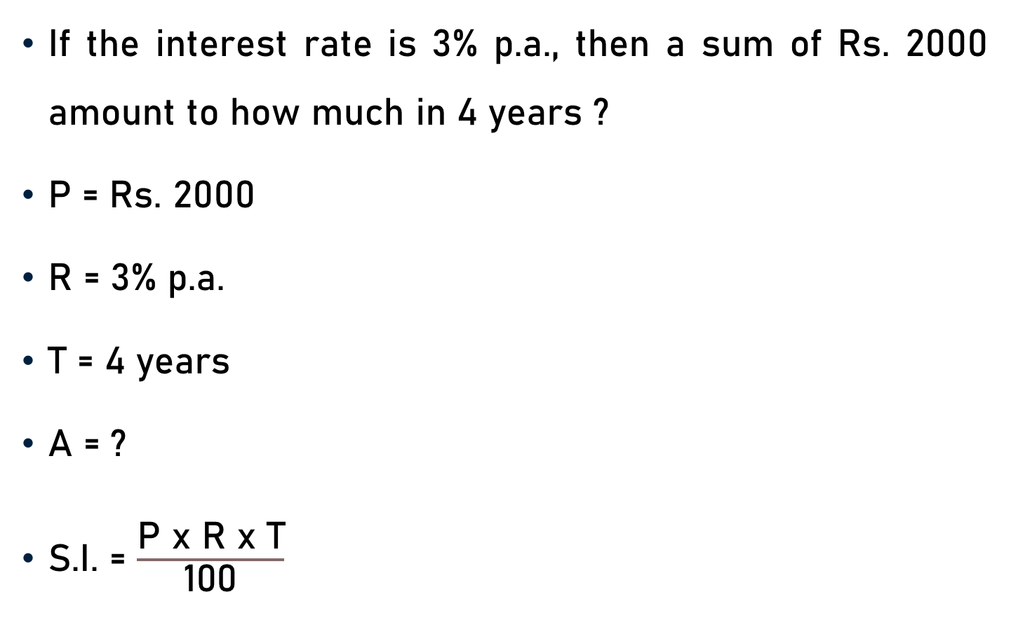
Problem 7
If the interest rate is 3% p.a., then a sum of Rs. 2000 amount to how much in 4 years ?
P = Rs. 2000
R = 3% p.a.
T = 4 years
A = ?
S.I. = $\frac{\text{P} \text{x} \text{R} \text{x} \text{T}}{\text{100}}$

Slide 16
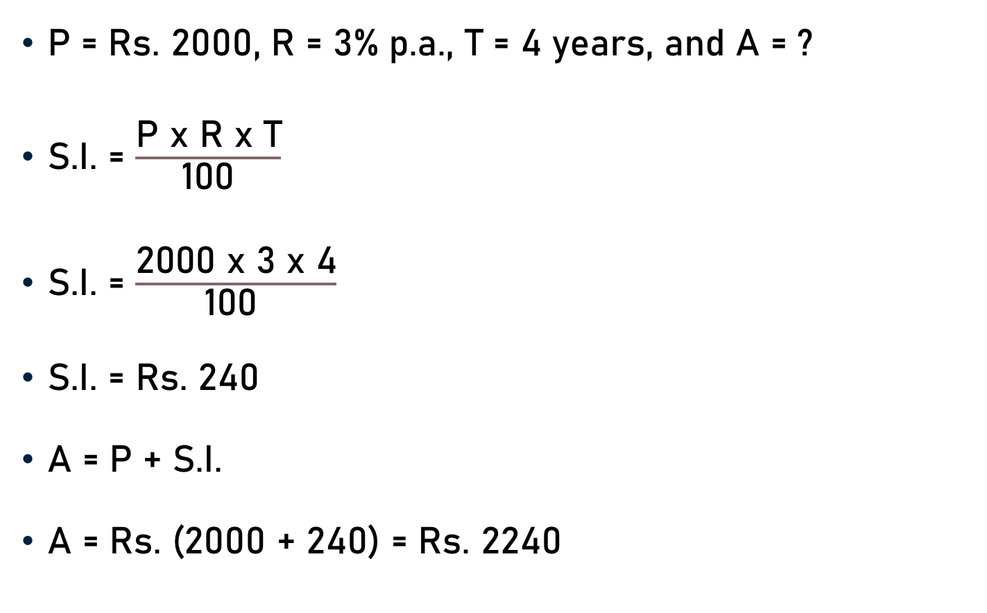
Problem 7
P = Rs. 2000, R = 3% p.a., T = 4 years, and A = ?
S.I. = $\frac{\text{P} \text{x} \text{R} \text{x} \text{T}}{\text{100}}$
S.I. = $\frac{\text{200}\text{0 }\text{x}\text{ 3 }\text{x}\text{ 4}}{\text{100 }}$
S.I. = Rs. 240
A = P + S.I.
A = Rs. (2000 + 240) = Rs. 2240
20

Slide 17
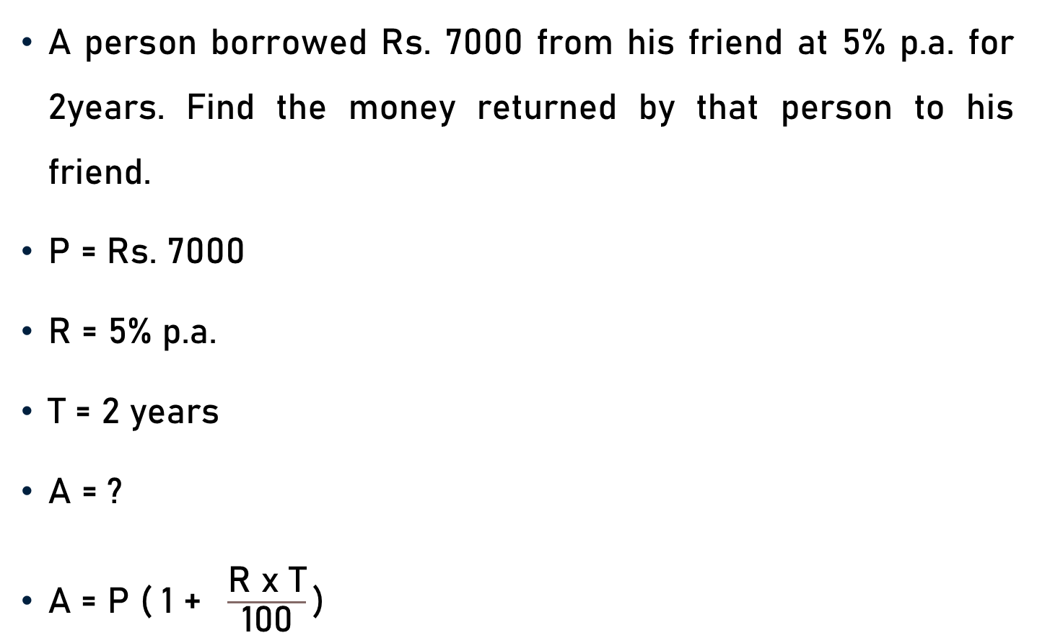
Problem 8
A person borrowed Rs. 7000 from his friend at 5% p.a. for 2years. Find the money returned by that person to his friend.
P = Rs. 7000
R = 5% p.a.
T = 2 years
A = ?
$\text{A}\text{ = }\text{P}\text{ ( 1 + }\frac{\text{R} \text{x} \text{T}}{\text{100}}\text{)}$

Slide 18

Problem 8
P = Rs. 7000, R = 5%, T = 2 years, and A = ?
$\text{A}\text{ = }\text{P}\text{ ( 1 + }\frac{\text{R} \text{x} \text{T}}{\text{100}}\text{)}$
$\text{A}\text{ = 7000 ( 1 + }\frac{\text{5} \text{x}\text{ 2}}{\text{100}}\text{)}$
$\text{A}\text{ = 7000 ( 1 + }\frac{\text{1}}{\text{10}}\text{)}$
$\text{A}\text{ = 7000 (}\frac{\text{10 + 1}}{\text{10}}\text{)}$
50
10

Slide 19

Problem 8
$\text{A}\text{ = 7000 (}\frac{\text{1}\text{0}\text{ +} \text{1}}{\text{10}}\text{)}$
$\text{A}\text{ = 7000 (}\frac{\text{1}\text{1}}{\text{10}}\text{)}$
A = Rs. 7700
700

Slide 20
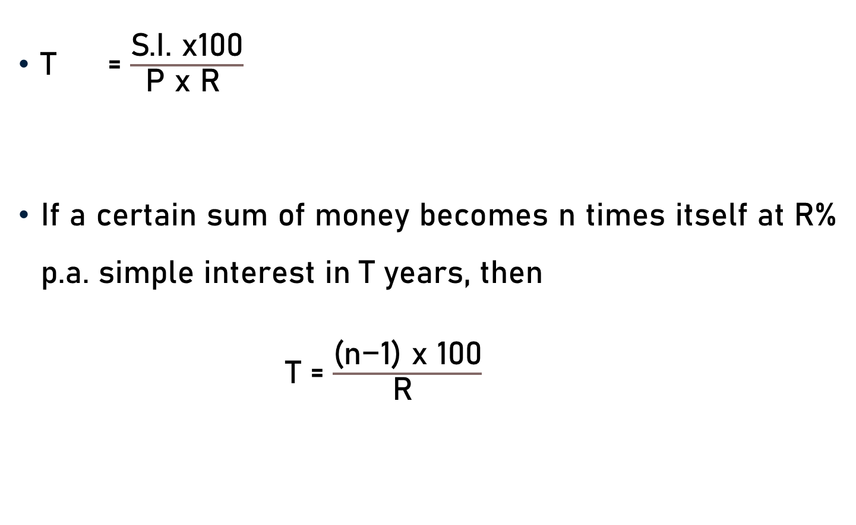
Conclusion
T = $\frac{\text{S}\text{.}\text{I}\text{. }\text{x}\text{100}}{\text{P} \text{x} \text{R} }$
If a certain sum of money becomes n times itself at R% p.a. simple interest in T years, then
$\text{T}$ = $\frac{\text{(}\text{n}\text{−1) }\text{x}\text{ 100}}{\text{R} }$

Slide 21
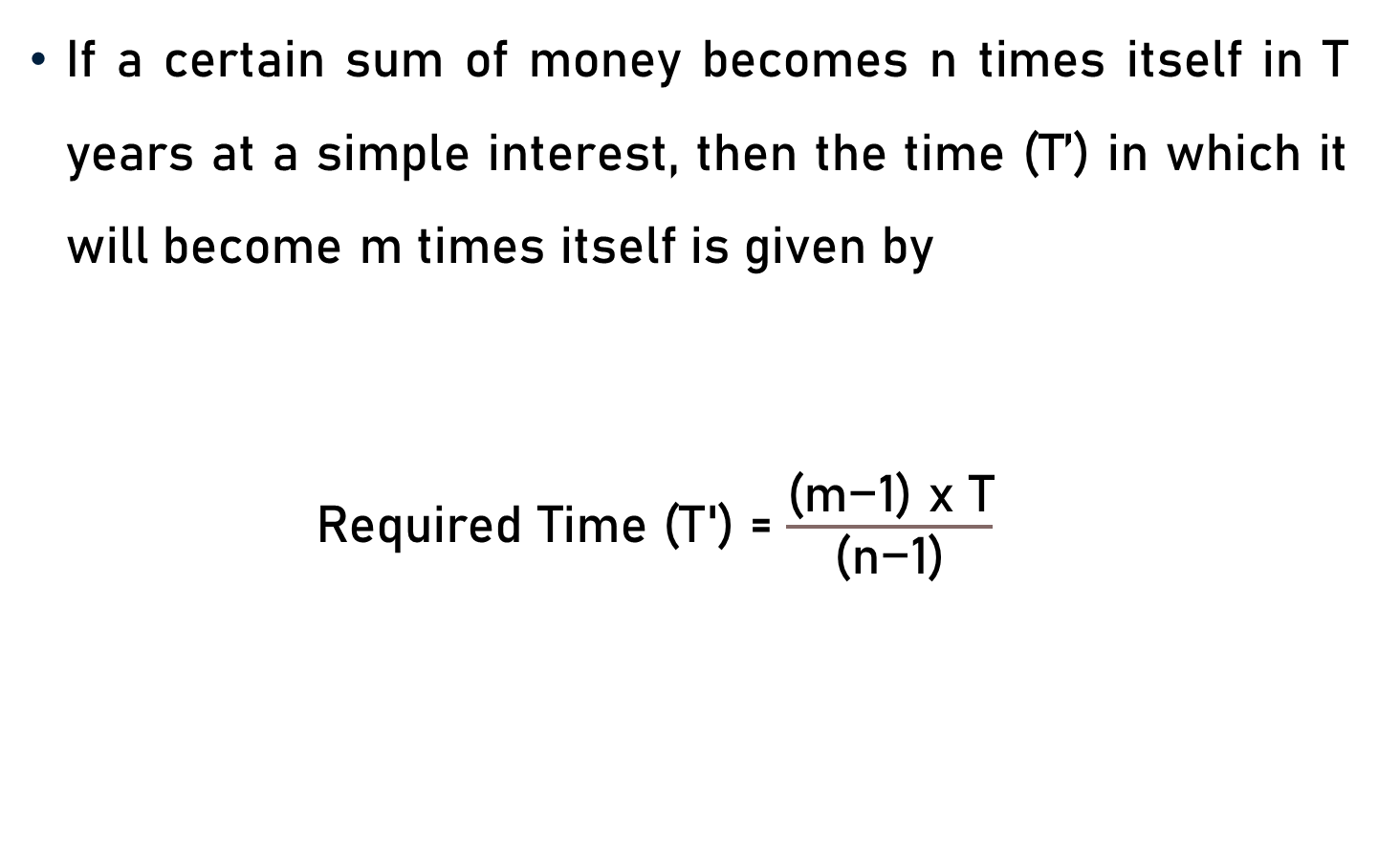
Conclusion
If a certain sum of money becomes n times itself in T years at a simple interest, then the time (T’) in which it will become m times itself is given by
$\text{Required} \text{Time}\text{ (}\text{T}\text{′) }$= $\frac{\text{(}\text{m}\text{−1) }\text{x} \text{T}}{\text{(}\text{n}\text{−1)}}$

Slide 22
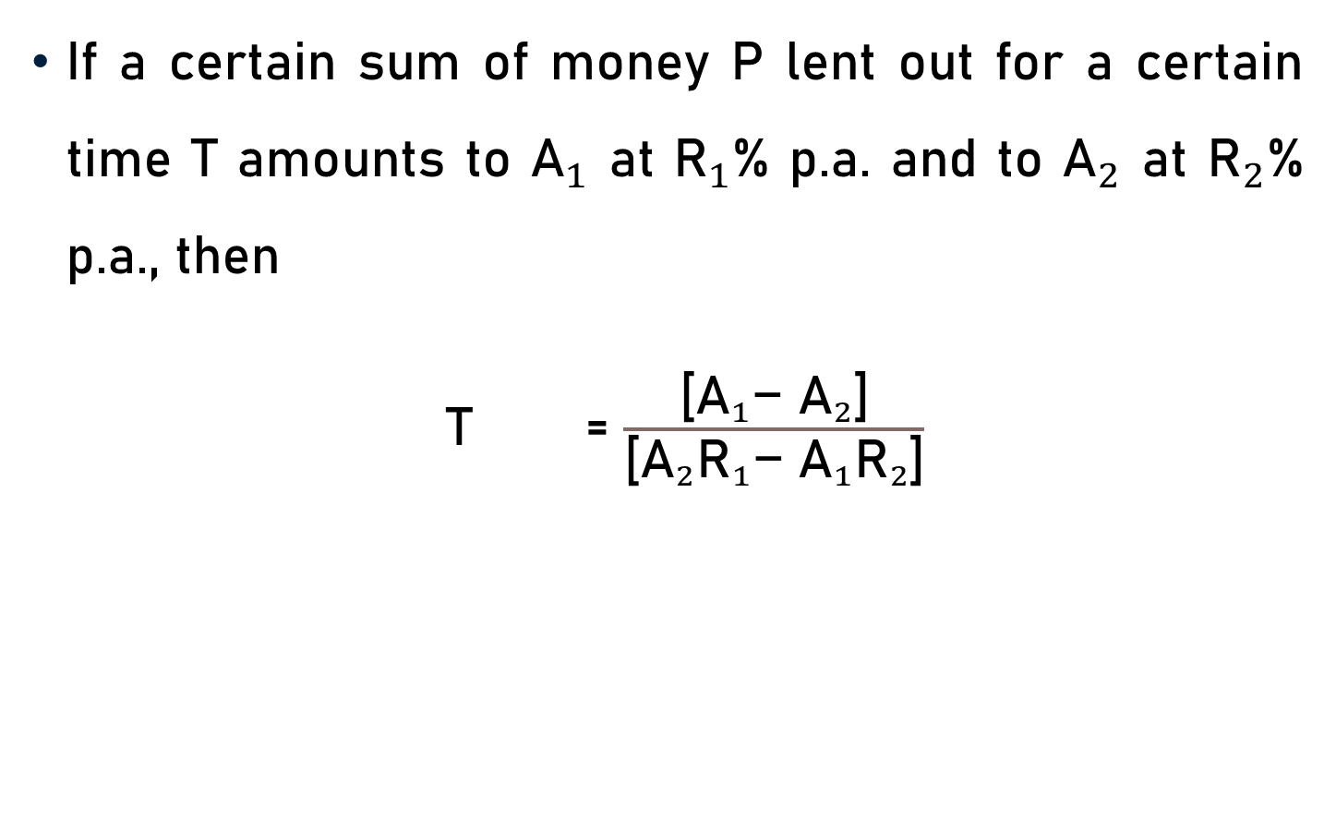
Conclusion
If a certain sum of money P lent out for a certain time T amounts to ${\text{A}}_{1}$ at ${\text{R}}_{1}$% p.a. and to ${\text{A}}_{2}$ at ${\text{R}}_{2}$% p.a., then
$\text{T}$ = $\frac{\text{[}{{\text{A}}_{1}\text{−} \text{A}}_{2}\text{]}}{\text{[}{\text{A}}_{2}{\text{R}}_{1}\text{−} {{\text{A}}_{1}\text{R}}_{2}\text{]}}$

Slide 23

Conclusion
A = P + S.I.
A = P ( 1 + $\frac{\text{R} \text{x} \text{T}}{\text{100}}$)

Slide 24
Summary
Computation of
  Time
  Amount

